Slide 1



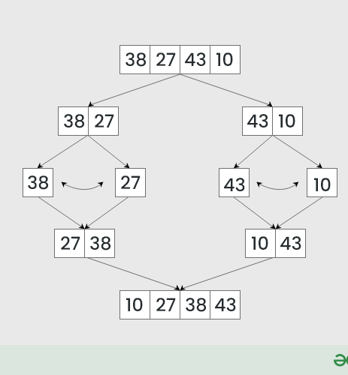
“MERGE SORT— DIVIDE & CONQUER SORTING”

Slide 2

MERGE SORT
It’s a sorting method that arranges numbers in order (like ascending or descending).
It works by dividing the list into parts, then merging them back in the correct order.
It is also called divide and conquer algorithm.
01

Slide 3
HOW IT WORKS
Merge Sort is a divide-and-conquer algorithm that works by splitting the input array into two halves, recursively sorting each half, and then merging the two sorted halves.
1. Divide: Divide the array into two halves until each sub-array has one element.
2. Conquer: Sort each sub-array (trivially sorted with one element).
3. Merge: Merge the sorted sub-arrays to form a single sorted array.
02

Slide 4
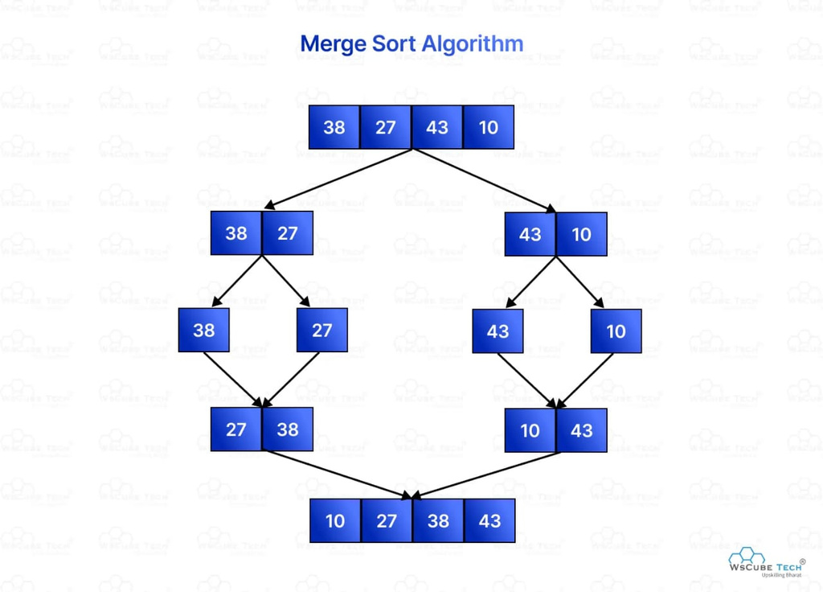
EXAMPLE
Array: 5, 2, 8, 3, 1, 6, 4
1. Divide: [5, 2, 8, 3] [1, 6, 4]
2. Divide: [5, 2] [8, 3] [1, 6] [4]
3. Divide: [5] [2] [8] [3] [1] [6] [4]
4. Merge: [2, 5] [3, 8] [1, 6] [4]
5. Merge: [2, 3, 5, 8] [1, 4, 6]
6. Merge: [1, 2, 3, 4, 5, 6, 8]
03

Slide 5
ALGORITHM
MERGE SORT
D IS THE NAME OF ARRAY.
A IS THE NAME OF ANOTHER TEMPORARY ARRAY.
Step 1. Set lb :=1 AND Set ub := n.
Step 2. FUNCTION divide (d,lb,ub)
Step 3. if (lb < ub) then
Set mid := (lb + ub)/2;
divide(d, lb, mid)
divide(d, mid+1, ub)
merge(d, lb, mid, ub)
[END OF FUNCTION divide]
Step 4. FUNCTION merge(d,lb,mid,ub)
Step 5. Set i := lb , j := mid+1 and k := lb.
04

Slide 6
ALGORITHM
Step 6. Repeat while (i<=mid) and (j<=ub)
Step 7. if d[i] <= d[j] then
Set a[k] := d[i]
Set i := i+1.
else Set a[k] := d[j]
and Set j := j+1
[END OF IF STRUCTURE]
Step 8. Set k := k+1.
[END OF STEP 6 LOOP]
Step 9. if(i > mid) then
Repeat while(j <= ub)
Set a[k] := d[j] and Set k := k+1
and Set j := j+1.
[END OF IF STRUCTURE]
Step 10.else Repeat while(i <= mid)
Set a[k] := d[i] and Set k := k+1 and Set i := i+1.
[END OF ELSE STRUCTURE]
[END OF STEP 9 LOOP]
STEP 11.REPEAT FOR k := lb TO ub
then Set d[k] := a[k]
[END OF STEP 11 LOOP]
[END OF MERGE FUNCTION]
STEP 12. EXIT.
05

Slide 7
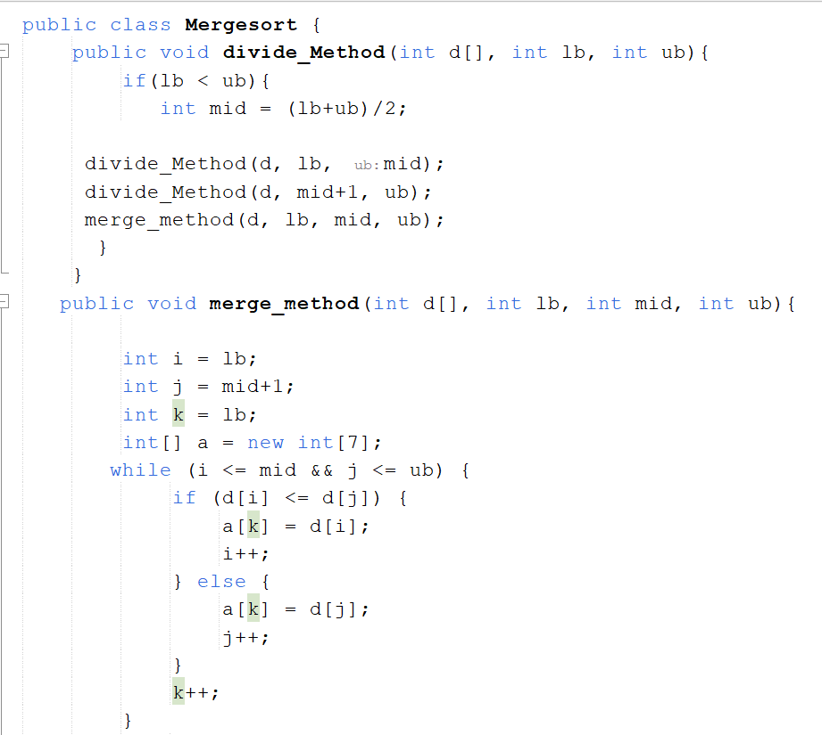
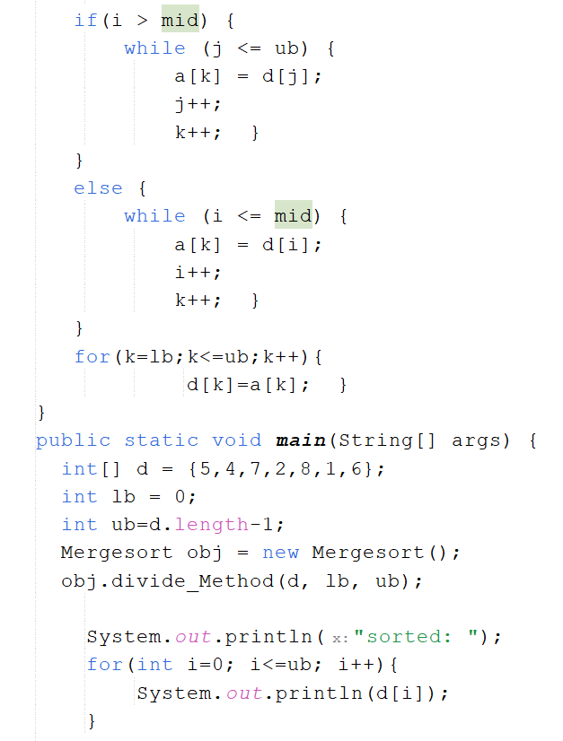
CODE
06

Slide 8
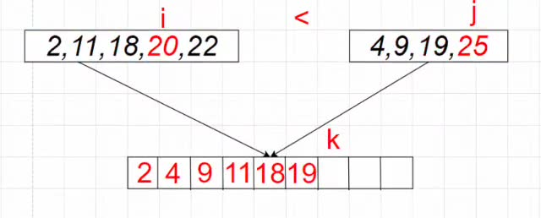
03

Slide 9
COMPLEXITY
Time Complexity
- Best-case: O(n log n)
- Average-case: O(n log n)
- Worst-case: O(n log n)
The time complexity of Merge Sort is O(n log n) because the array is divided into two halves at each level, and the merge operation takes O(n) time.
07

Slide 10
REAL-LIFE EXAMPLE
Imagine organizing a library’s books alphabetically.
1. Divide:
Split books into small groups (A–F, G–L, M–R, S–Z).
2. Sort:
Sort each group alphabetically.
3. Merge:
Combine the sorted groups by comparing the first book of each and placing the one that comes first alphabetically until all are merged.
✅ Final list = fully sorted books.
09

Slide 11
ADVANTAGES
Stable Sorting Algorithm: Maintains the relative order of equal elements.
Guaranteed Time Complexity: O(n log n) in all cases (best, average, worst).
Efficient for Large Data Sets: Suitable for sorting large data sets.
Easy to Implement: Simple to understand and implement.
10

Slide 12
DISADVANTAGES
- Space Complexity: O(n) - requires extra space for merging
- Not In-Place: Requires additional storage for the merged array
- Slower than Quick Sort: Generally slower than Quick Sort for smaller data sets
- Limited memory: Avoid using Merge Sort when working with limited memory resources.
- Small datasets: For small datasets, other sorting algorithms like Insertion Sort may be more efficient.
11

Slide 13
SUMMARY
Merge Sort follows the Divide → Conquer →
Combine strategy.
It’s fast, stable, and great for handling large
amounts of data.
It consistently divides the data until each subarray has only one element , then merges the subarrays step-by-step to produce a fully sorted array.
Efficient, elegant, and widely used in programming.
12

Slide 14
THANK YOU
13

